Slide 1
Bingham Canyon Mine
Pawlenko Maxym OB-51m

Slide 2
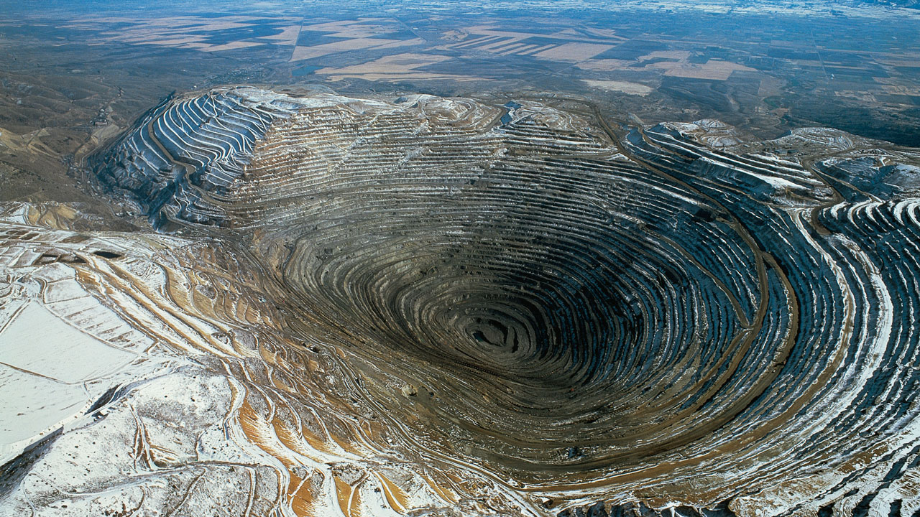

Slide 3
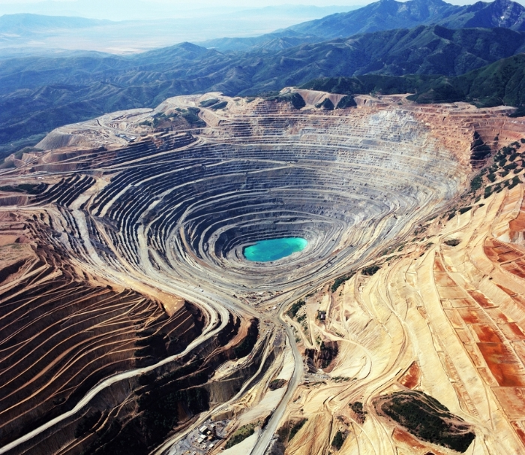
The Bingham Canyon Mine, more commonly known as Kennecott Copper Mine among locals, is an open-pit mining operation extracting a large porphyry copper deposit southwest of Salt Lake City, Utah, USA, in the Oquirrh Mountains. The mine is the largest man-made excavation in the world. The mine is owned by Rio Tinto Group, an international mining and exploration company headquartered in the United Kingdom. The copper operations at Bingham Canyon Mine are managed through Kennecott Utah Copper Corporation which operates the mine, a plant, a smelter, and a refinery. The mine has been concentrator in production since 1906, and has resulted in the creation of a pit over 0.6 miles (0.97 km) deep, 2.5 miles (4 km) wide, and covering 1,900 acres (770 ha). It was designated a National Historic Landmark in 1966 under the name Bingham Canyon Open Pit Copper Mine. The mine experienced a massive landslide in April 2013 and a smaller slide in September 2013.

Slide 4
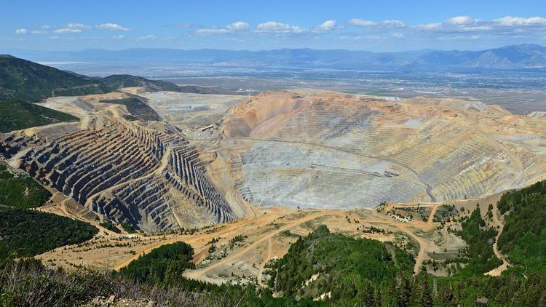
History
Minerals, in the form of copper ore, were first discovered in Bingham Canyon in 1848 by two brothers, Sanford and Thomas Bingham, sons of Erastus Bingham, Mormon pioneers of September 1847, who grazed their cattle there. They reported their find to their leader, Brigham Young, who advised against pursuing mining operations because the survival and establishment of settlements was of paramount importance at that time. The brothers applied themselves to that purpose as directed and did not stake a claim. In 1850, the Bingham family went to settle what is now Weber County, leaving the canyon still today known by their name.

Slide 5
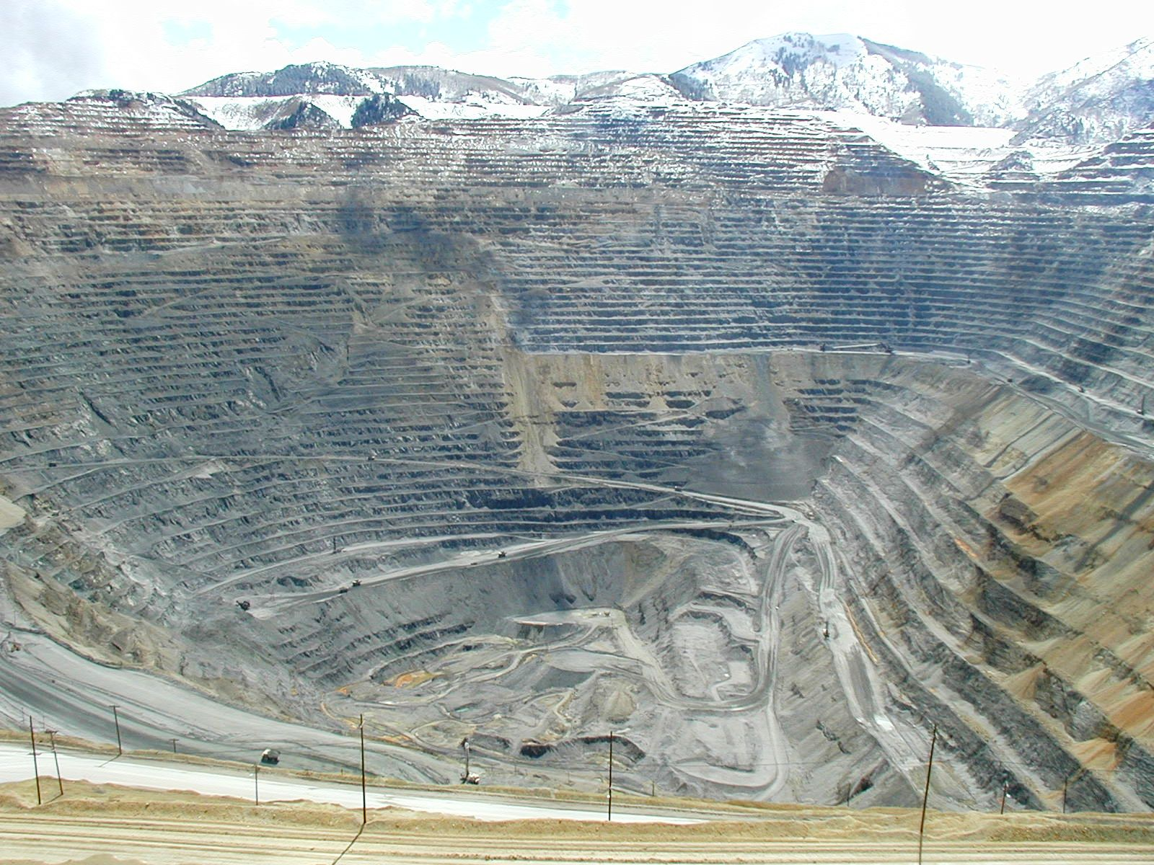
It was not until 17 Sept. 1863 that extraction of ore began and the potential of the canyon's mineral resources began to be widely recognized. That was when George B. Ogilvie and twenty-three others "located the West Jordan claim", soon followed by the Vidette claim. At first, mining was confined to placer gold, lead-silver and copper-gold. Porphyry copper required processing and a railroad, which reached the canyon in 1873.
Enos Andrew Wall started working claims in 1887. His extensive tunnels and test pits, on his 200 acres, indicated ore containing 2% copper.
The canyon's nineteenth-century mines were relatively small, but it wasn't until the end of the century that very large-scale exploitation of the canyon's ore bodies began to develop with open-pit mining. In 1896, Samuel Newhouse and Thomas Weir acquired the Highland Boy Mine,
which was rich in copper, silver and gold. Together they formed the Utah Consolidated Gold Mines, Ltd. with English investors. They then formed the Boston Consolidated Gold and Copper Co., Ltd., for development of low-grade copper ore adjacent to the Utah Copper Company site/ Another significant development took place in 1903, when Daniel C. Jackling and Enos A. Wall organized the Utah Copper Company. Utah Copper immediately began construction of a pilot mill at Copperton, just beyond the mouth of the canyon, and the company actually started mining in 1906.

Slide 6
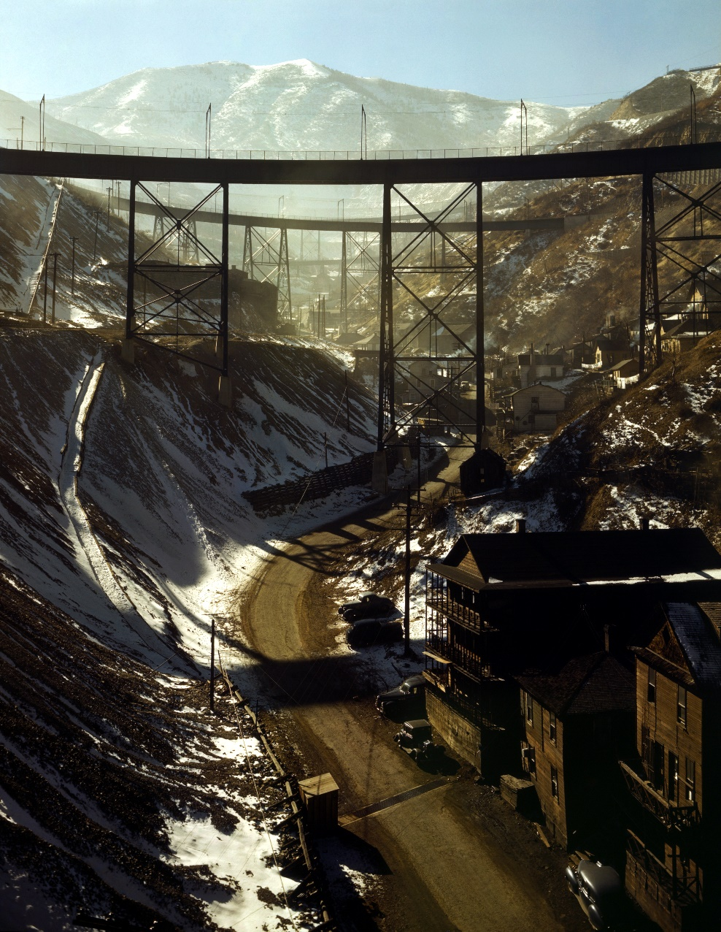
Bingham's Canyon mine expanded rapidly, and by the 1920s the region was a beehive of activity. Some 15,000 people of widely varying ethnicity lived in the canyon, in large residential communities constructed on the steep canyon walls. The population declined rapidly as mining techniques improved, however, and several of the mining camps began to be swallowed up by the ever-expanding mine. By 1980, when Lark was dismantled, only Copperton, at the mouth of Bingham Canyon and with a population of 800, remained.
The twenty-one separate mining operations in existence by 1911 were consolidated down to two in 1970, Kennecott and The Anaconda Minerals Company. In 1985 open-pit mining operations were halted by Kennecott's Utah Copper. In 1986, Kennecott discovered gold in nearby Barney's Canyon.[9]
KCC was purchased by Sohio in 1981 and the mine reopened in 1987 after BP Minerals purchased the assets. In 1989 the Rio Tinto Group acquired the asset, who modernized the mine, mill and smelter.[8]:9
The open-pit owners replaced an antiquated 1000-car railroad with conveyor belts and pipelines for transporting the ore and waste, which reduced costs by nearly 30 percent and returned the operation to profitability.
Bingham Canyon Mine, November 1942. Carr Fork Canyon as seen from "G" bridge.

Slide 7
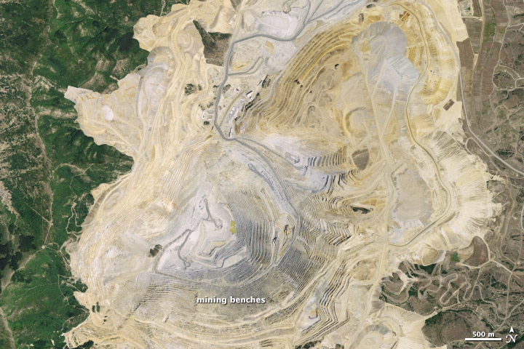
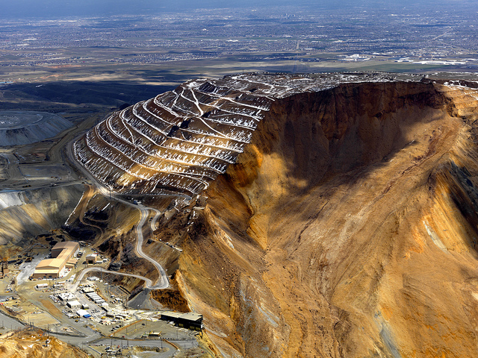
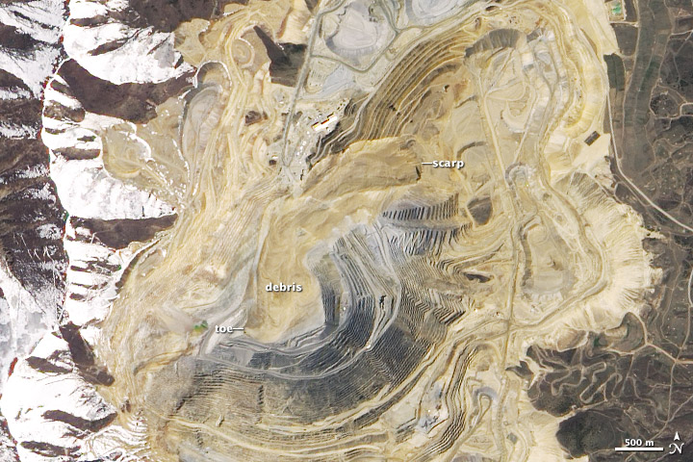
At 9:30 pm on April 10, 2013, a landslide occurred at the mine. It was the largest non-volcanic landslide in the history of North America. Around 65–70 million cubic meters (2.3×109–2.5×109 cu ft) of dirt and rock thundered down the side of the pit. Understanding that the mine's steep walls made it a high risk for landslides, an interferometric radar system had been installed to monitor the ground's stability. As a result of warnings produced by this system, mining operations were shut down the previous day in anticipation of the slide. There were no injuries. The massive slide is expected to cut production of mined copper by 100,000 tonnes (110,000 short tons).A second slide caused an evacuation of 100 workers on September 11, 2013.

Slide 8
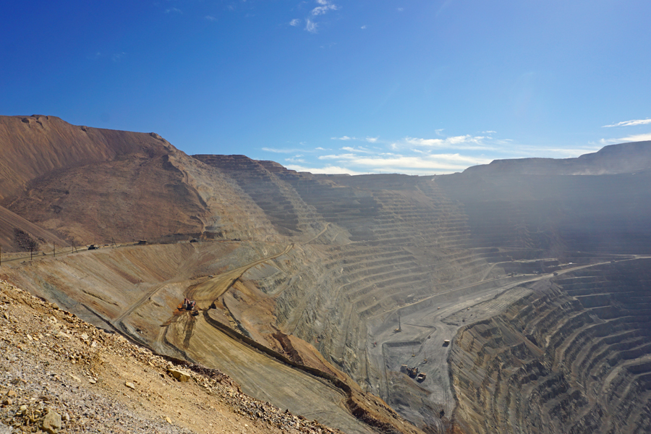
The extracted ore is treated at the Kennecott smelter at nearby Magna, Utah. The ore is run through a concentrator, where huge grinding mills reduce it to the consistency of face powder.[17] Flotation then separates the gangue from the metalliferous particles, which float off as a 28-percent concentrate of copper along with lesser amounts of silver, gold, lead, molybdenum, platinum and palladium. A selective flotation step separates the molybdenite (molybdenum disulfide) from the chalcopyrite.
The filtered concentrate slurry is piped 17 miles (27 km) to the smelter, where it is dried, and then injected along with oxygen into a flash smelting furnace to oxidize the iron and sulfur. The oxidized iron is skimmed off, while the sulfur dioxide gas is captured and sent to an on-site acid plant for conversion to valuable sulfuric acid - a million tons of it each year. Left behind is a molten copper sulfide called matte. The 70-percent-copper matte is water-quenched to form a sand-like solid, then injected, with oxygen, into a flash-converting furnace that produces molten, 98.6-percent-pure copper. This copper is then cast into 700-pound (320 kg) anode plates and shipped by rail to the refinery.
At the refinery, the anode plates are pressed flat and interleaved with stainless steel cathode blanks. Automated robotic vehicles place the prepared anodes in cells containing an acidic electrolyte. When the cells are electrified, the anodes slowly dissolve, freeing copper ions that are deposited on the cathode as 99.99-percent-pure copper.
Impurities and precious metals settle to the bottom of the electrolytic cells as anode slimes. A chlorination leaching process recovers the gold and silver, which is melted in induction furnaces.

Slide 9
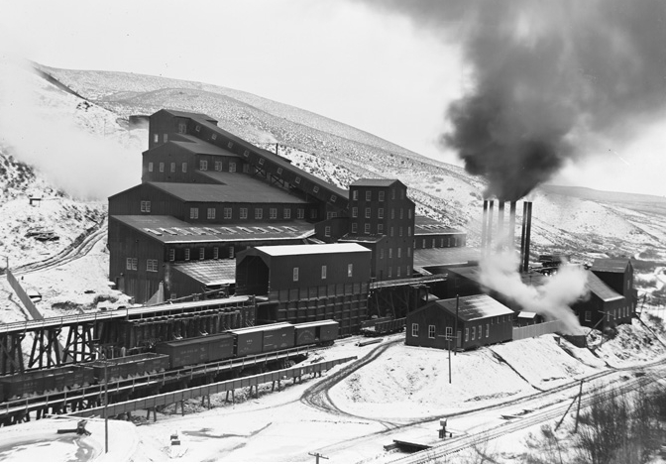
Kennecott’s Bingham Canyon Mine is the largest man-made
excavation in the world, and some[who?] claim that it is the
only manmade feature visible to the naked eye from an
orbiting space shuttle.[18][19][20] Employing
1,800 employees and hundreds of contractors[when?],
450,000 short tons (400,000 long tons; 410,000 t) of
material are removed from the mine daily. Electric
shovels can carry up to 56 cubic yards (43 m3) or 98
short tons (88 long tons; 89 t) of ore in a single scoop.
Ore is loaded into a fleet of 64 large dump trucks which
each carry 255 short tons (228 long tons; 231 t) of ore at a
time; the trucks themselves cost about $3 million each.
There is a five-mile (8 km) series of conveyors that take
ore to the Copperton concentrator and flotation plant.
The longest conveyor is 3 miles (4.8 km) long.[
As of 2010, Kennecott Utah Copper was the second largest copper producer in the US, and provided about 13-18% percent of the U.S.'s copper needs.[18][19] It is one of the top producing copper mines in the world with production at more than 18.7 million short tons (16.7 million long tons; 17.0 Mt). Every year, Kennecott produces approximately 300 thousand short tons (272 kt or 268 thousand long tons) of copper, along with 400 thousand troy ounces (13.7 short tons 12.4 tonnes, or 12.2 long tons) of gold, 4 million troy ounces (124 tonnes, 137 short tons or 122 long tons) of silver, about 10 thousand short tons (9,100 tonnes or 8,900 long tons) of molybdenum,[18] and about a million short tons (910 kt or 890 thousand long tons) of sulfuric acid, a by-product of the smelting process.[20] Rio Tinto purchased Kennecott Utah Copper in 1989 and has invested about $2 billion in the modernization of KUC’s operations. The current mine plan will expire in 2019. Rio Tinto has been studying a plan to extend the open pit 1,000 feet (305 m) southward, which would extend the life of the mine into the mid-2030s. The plan has been contingent on approval by the Rio Tinto board of directors and approximately 25 required environmental permits.

Slide 10
THE END

